Slide 1

1st National Conference on Sustainable Civil Engineering & Geospatial Technologies: Materials & Innovations for Climate Resilience (NCRT-SCE 2026) Buddha Institute of Technology GIDA, Gorakhpur Date of Conference: 15th – 16th April 2026
“Fabrication Of Grey Water Filtration System” JALRAKSHAK BIOPURE
Presented By:
Dhananjay Yadav
2305250009012
4th Year
Under the Guidance
Mr. Pratish Kannaujiya
Assistant Professor
Department of Civil Engineering, BIT Gorakhpur

Slide 2
Contents
Introduction
Problem Statement
Objectives
Literature Survey
Proposed Solution / Methodology
Results & Analysis
Conclusion & Future Work
Acknowledgements
References

Slide 3
Introduction
Background:
Water is essential for human life and the environment.
A major portion (75–90%) of household wastewater is greywater.
Greywater comes from sources like bathing, laundry, and kitchen (excluding toilet waste).
It contains soaps, detergents, and low organic pollutants, making it suitable for treatment and reuse.
Importance:
Reusing greywater helps in reducing the demand for freshwater.
It decreases the load on sewage treatment systems.
Treated greywater can be used for non-potable purposes like gardening, flushing, and cleaning.
Context:
India is facing serious water scarcity, especially in urban and semi-arid regions.
Rainwater harvesting alone is not sufficient due to irregular rainfall.
Greywater reuse is a cost-effective and practical solution to this problem.
This project focuses on designing and fabricating a low-cost greywater filtration system (Jalrakshak Biopure).

Slide 4
Problem Statement
Define the Problem:
Increasing water scarcity in India, especially in urban and semi-arid regions.
Large amount of household greywater is wasted without treatment.
Untreated greywater adds pollution to water bodies and increases sewage load.
Why It Matters:
Freshwater resources are limited and depleting rapidly.
Efficient water management is essential for sustainable development.
Reusing greywater can significantly reduce water demand and environmental impact.
Current Gap:
Lack of affordable and efficient greywater treatment systems at household level.
Limited awareness about greywater reuse.
Existing solutions are often costly or complex for common use.

Slide 5
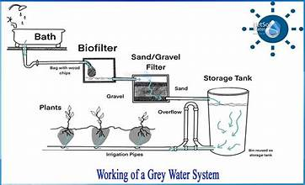
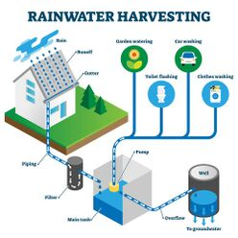
Objectives
Objective 1:
To reduce the use of freshwater by reusing treated greywater.
Objective 2:
To treat greywater so it can be safely used for non-potable purposes like flushing, gardening, and cleaning.
Objective 3:
To design and fabricate a low-cost and efficient greywater filtration system.
Objective 4:
To analyze the physical, chemical, and biological properties of greywater.
To evaluate the performance and effectiveness of the filtration system.

Slide 6
Literature Survey
Piyush Gupta (2016) performed "Design and Performance Evaluation of a Greywater Treatment System for Residential Complexes in India".
Himanshu Joshi (2017) performed the Evaluation of Low-Cost Greywater Treatment Systems for Urban Areas in India. This research article evaluates the performance of low-cost greywater treatment systems suitable for urban areas in India.
Shashwat G. Mishra (2018) did the task on Assessment of Greywater Treatment Technologies for Urban India. This study assesses different greywater treatment technologies for urban India.
Keshav Mohan(2021) performed Greywater Recycling for Domestic Use in India. This review article explores the opportunities, challenges, and perspectives of greywater recycling for domestic use in India.

Slide 7
Proposed Solution
Approach:
A multi-stage greywater filtration system is designed for effective treatment.
Combination of physical, chemical, and biological processes is used.
Gravity-based flow along with pump-assisted filtration ensures smooth operation.
Techniques:
Layered filtration using sand, gravel, charcoal, and coconut husk.
Adsorption process to remove odor, color, and chemicals.
RO and UV treatment for final purification and disinfection.
Water quality testing (pH, TDS, BOD, COD) before and after treatment.
Tools:
Biofilter materials: sand, gravel, charcoal, coconut husk.
Filtration units: sediment filter, carbon filter, RO filter, UV filter.
Equipment: booster pump, pipes, containers, pH meter.

Slide 8
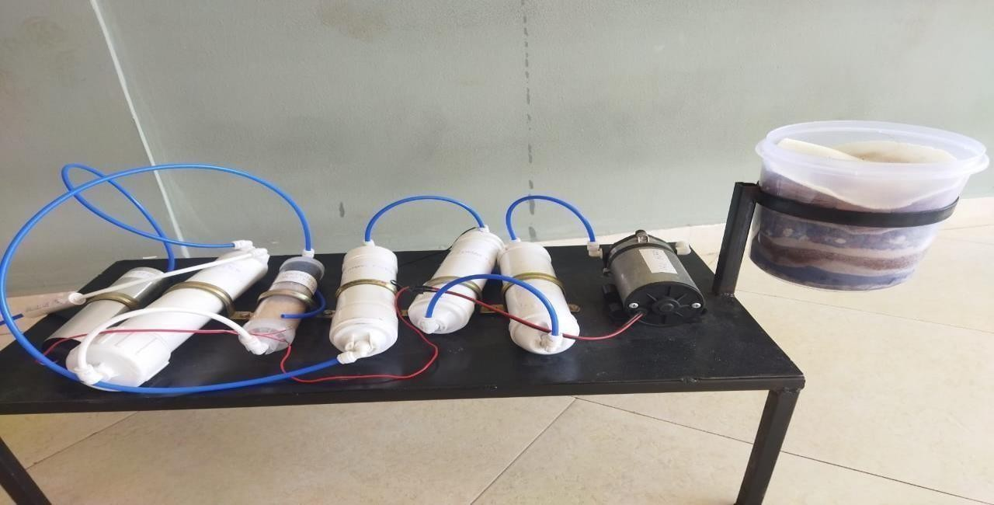
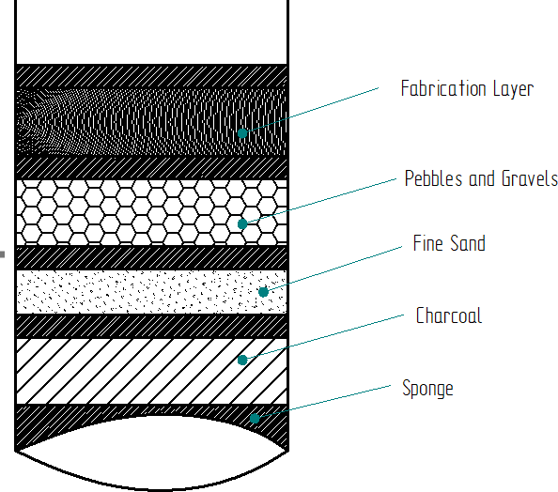
Cont....
Equipment and Filtration Units
Composition of Biofilter
Methodology:
Collect greywater sample.
Prepare Biofilter with multiple layers.
Pass water through booster pump and filters (sediment, carbon, mineral).
Final treatment with RO and UV filters.
Test pH before and after treatment.
Biofilter acts as first stage removing large particles and improving clarity.
Sequential flow through filters ensures progressive water quality improvement.

Slide 9
Cont....
Block Diagram of Grey Water Filtration
Grey water
Bio filter
Filtered Water
Booster Pump
Sedimentation Filter
Carbon Filter
Mineral Cartridge Filter
RO Filter
UV Filter
Purified Water

Slide 10
Results & Analysis
Graphs:
pH improved closer to neutral after complete filtration.
Graphical representation shows improvement in ph.
8
7
6
5
4
3
2
1
Ph Values
grey
fine
gravel
Water
charco
pre
p
Schematic Graphical representation of different pH values
Sl. No | Sample | pH values
1 | Grey Water sample | 6.83
2 | Fine Sand sample | 5.9
3 | Charcoal sample | 6.97
4 | Gravel sample | 6.94
5 | Pre sample | 6.6
pH Test for different water

Slide 11
Cont....
Comparison:
Untreated greywater: high turbidity, odor, and pollutants.
Treated greywater: cleaner, safer, and usable for non-potable purposes.
Clear difference shows effectiveness of the filtration system.
Sr. No's | Parameter | Unit | Before Filtration (Sample A) | After Filtration (Sample B) | Permissible Limit (for Non-potable
1 | pH | – | 6.83 | 7.05 | 6.5 – 8.5
2 | Turbidity | NTU | 58 | 6.5 | <10
3 | TDS (Total Dissolved Solids) | mg/L | 950 | 480 | <2000
4 | BOD(Biochemical Oxygen Demand) | mg/L | 120 | 25 | <30
5 | COD(Chemical Oxygen Demand) | mg/L | 280 | 65 | <100
6 | DO (Dissolved Oxygen) | mg/L | 2.1 | 6.4 | >4
7 | Hardness (as CaCO₃) | mg/L | 410 | 190 | <500
8 | Odour | – | Unpleasant | Odourless | –
9 | Color | – | Greyish | Clear | –
water samples before and after Filtration

Slide 12
Cont....
Interpretation:
Filtration system effectively removes suspended and dissolved impurities.
Improvement in pH indicates better water stability.
Reduction in BOD and COD shows decreased organic pollution.
Overall system proves efficient and reliable.
Key Outcomes:
Significant reduction in impurities and pollutants.
TDS reduced from 950 mg/L to 480 mg/L.
BOD reduced from 120 mg/L to 25 mg/L.
COD reduced from 280 mg/L to 65 mg/L.
pH stabilized from 6.83 to 7.05 (near neutral).
Water became clear, odorless and suitable for reuse.

Slide 13
Conclusion & Future Work
Conclusions:
Greywater treatment is a cost-effective and eco-friendly method of water conservation.
It reduces fresh water demand by reusing up to 70% of household wastewater.
Final treated water is suitable for non-potable uses such as flushing, irrigation, and cleaning.
Promotes sustainable water management at household and community levels.
Future Work:
Future improvements in greywater treatment systems.
Enhance filtration efficiency with advanced materials.
Develop compact, modular, and portable designs.
Use IoT-based monitoring for water quality testing.
Recover useful resources like nutrients during treatment.
Government policies and awareness campaigns for adoption.

Slide 14
Acknowledgements
Guide:
I would like to express my sincere and heartfelt gratitude to my respected guide Mr. Pratish Kannaujiya, Assistant Professor & Incubation Manager (BIC), Department of Civil Engineering, for his constant guidance, valuable suggestions, motivation, and continuous support throughout the completion of this research work.
I am highly thankful to our Head of Department Mr. Baijnath Nishad for providing the necessary facilities and academic support.
I extend my heartfelt thanks to the Research Head Mr. Ankur Kumar for his guidance and valuable suggestions.
Institution:
I would also like to express my sincere thanks to Buddha Institute of Technology, Gorakhpur for providing a supportive academic environment, necessary resources, and infrastructure facilities which made this research work possible. I am also thankful to the Department of Civil Engineering for their cooperation and support.

Slide 15
References
Akbari, Z., et al. (2025) Optimal design of a hybrid system composed of coagulation process and multi-stage filtration unit for on-site treatment of greywater in rural area. Applied Water Science (Springer) 🔗 View Article
Oteng-Peprah, M., et al. (2018) Greywater characteristics, treatment systems, reuse strategies and user perception – A review. Water, Air, & Soil Pollution (Springer) 🔗 https://link.springer.com/article/10.1007/s11270-018-3909-8
Shaikh, I. N., & Ahammed, M. M. (2022) Granular media filtration for on-site treatment of greywater: A review. Water Science & Technology 🔗 https://pubmed.ncbi.nlm.nih.gov/36358042/
Spychała, M., et al. (2019) Removal of volatile solids from greywater using sand filters. Applied Sciences (MDPI) 🔗 https://www.mdpi.com/2076-3417/9/4/770

Slide 16
Thank You

